Slide 1

CS 533 INTRO TO DATA SCIENCE
Michael Ekstrand

Slide 2
T-TESTS

Slide 3

Learning Outcomes
Select the appropriate form of T-test for a value
Understand what the T-test does
Photo by Jonathan Farber on Unsplash

Slide 4
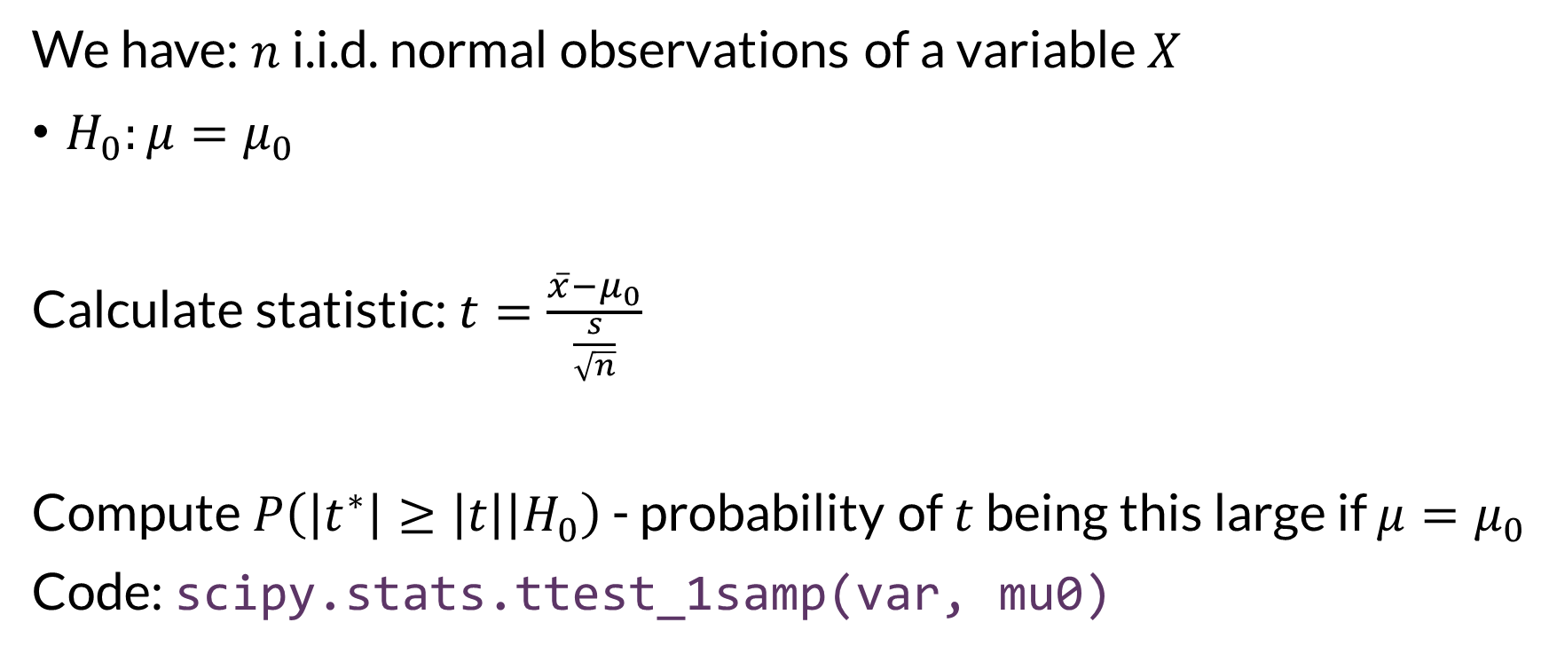

Single Variable
We have: $n$ i.i.d. normal observations of a variable $X$
$H_{0}:μ=μ_{0}$
Calculate statistic: $t=\frac{\overline{x}−μ_{0}}{\frac{s}{\sqrt{n}}}$
Compute $P\left(\left|t^{∗}\right|≥\left|t\right| | H_{0}\right)$ - probability of $t$ being this large if $μ=μ_{0}$
Code: scipy.stats.ttest_1samp(var, mu0)

Slide 5
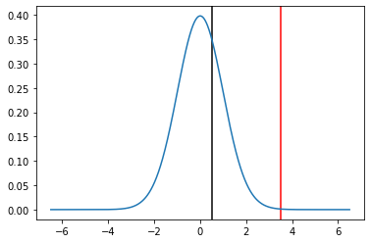


Distribution Under the Null
Under the null, the t-statistic follows the t-distribution with $n−1$ degrees of freedom.

Slide 6
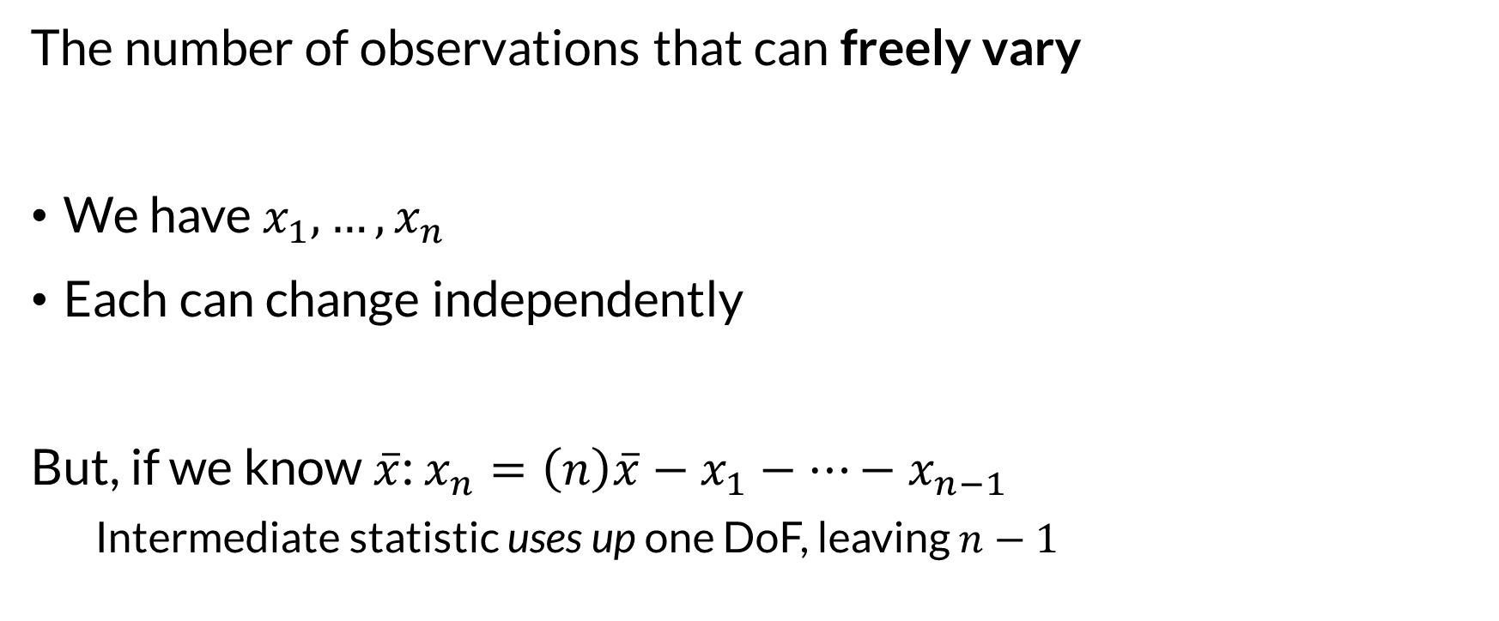
Degrees of Freedom
The number of observations that can freely vary
We have $x_{1},…,x_{n}$
Each can change independently
But, if we know $\overline{x}$: $x_{n}=\left(n\right)\overline{x}−x_{1}−…−x_{n−1}$
Intermediate statistic uses up one DoF, leaving $n−1$

Slide 7
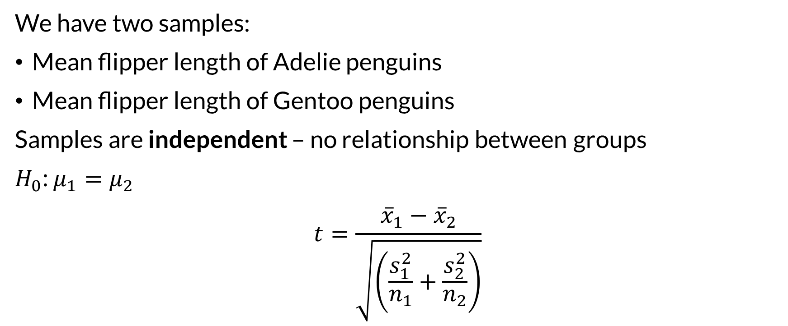

Two-Sample T-test
We have two samples:
Mean flipper length of Adelie penguins
Mean flipper length of Gentoo penguins
Samples are independent – no relationship between groups
$H_{0}$: $μ_{1}=μ_{2}$
$$t=\frac{{\overline{x}}_{1}−{\overline{x}}_{2}}{\sqrt{\left(\frac{s_{1}^{2}}{n_{1}}+\frac{s_{2}^{2}}{n_{2}}\right)}}$$

Slide 8
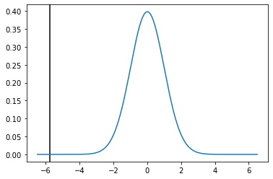

Penguin T-test Results
Statistic: $−5.78$
P-value: $6.05×{10}^{−8}$

Slide 9
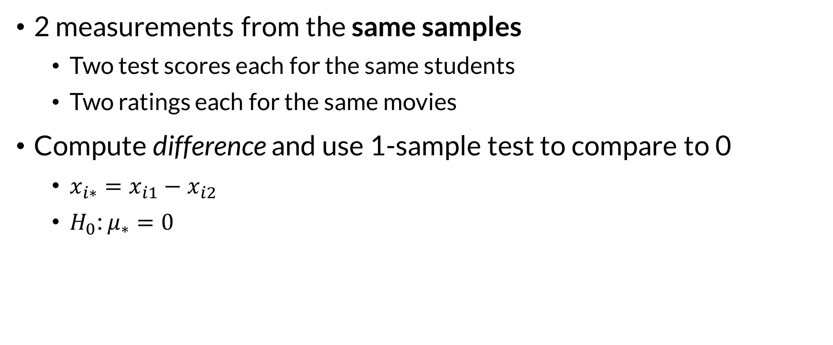
Paired T-tests
2 measurements from the same samples
Two test scores each for the same students
Two ratings each for the same movies
Compute difference and use 1-sample test to compare to 0
$x_{i∗}=x_{i1}−x_{i2}$
$H_{0}$: $μ_{∗}=0$

Slide 10
Tests
One sample, mean: one-sample t-test
Scipy ttest_1samp
Paired measurements: paired t-test
Scipy ttest_rel, or use 1samp on differences
Two independent samples: two-sample independent t-test
Scipy ttest_ind
Warning: assumes equal variance by default – turn off with equal_var=False

Slide 11
Other Tests
This is the usual practice for a significance test:
Compute statistic
Compare to distribution under null hypothesis
Can bootstrap them too

Slide 12

Wrapping Up
Significance tests compute the probability of a statistic under the null hypothesis.
The T-test does this with the t-statistic, a standardized mean.

